Slide 1

Explainable Machine Learning Framework for Early Heart Disease Prediction
Under the esteemed guidance of – Dr. Swanthana
Section – 7
Group-8
2420030503-K. Anoop
2420030490 -V.Sree
2420030582-Sameera.M
2420030537-Souraja.M

Slide 2
Problem Statement
Heart disease is one of the leading causes of death worldwide. Many ML models predict it accurately but act as black boxes.
Doctors need transparent and interpretable prediction systems. The system should explain the medical factors behind each prediction.
An Explainable Machine Learning Framework is required. It provides accurate predictions with clear explanations for better clinical decisions.

Slide 3
Objectives
To develop an accurate machine learning model for early heart disease prediction.
To identify and select the most relevant clinical features influencing heart disease risk.
To evaluate and compare different machine learning models based on their prediction performance.
To integrate Explainable AI techniques such as SHAP and LIME for interpreting predictions.
To provide transparent and understandable insights that support early diagnosis and clinical decision-making.

Slide 4
Literature Survey
No. | Research Paper Title | Model / Method | Outcome | Limitations | Dataset Used | Dataset Link
1 | Interpretable Machine Learning Model For Heart Disease Prediction | 2023 | SVM, RF, XGBoost, KNN + SHAP + LIME | SVM and XGBoost reached F1 up to about 88%; SHAP identified important variables and LIME explained individual classifications. | Benchmark-data scope limits generalization; post-hoc explanations depend on the model and data. | Open dataset
2 | Integrating explainable machine learning and user-centric model for diagnosing cardiovascular disease: A novel approach | 2024 | DT, KNN, RF, XGB + SHAP + interface | Four classifiers were tested; KNN reported 71% accuracy and SHAP explanations were embedded in a diagnostic interface. | Modest predictive performance; dataset is available on request; further clinical validation is needed. | Not public / on request
3 | A proposed technique for predicting heart disease using machine learning algorithms and an explainable AI method | 2024 | SMOTE + multiple ML models + XGBoost + SHAP | XGBoost achieved 97.57% accuracy and 98% AUC on the combined/SF-2 setup; SHAP explained predictions. | Cleveland plus private data limits availability/representativeness; class imbalance and domain adaptation remain concerns. | Open dataset
4 | Explainable AI-driven machine learning for heart disease detection using ECG signal | 2024 | RF/XGBoost + DWT/EWT + SHAP | EWT+XGBoost achieved strong AUCs across PhysioNet 2016, PASCAL and MIT-BIH datasets. | Signal-focused pipeline is complex; extensive preprocessing/feature extraction is required; broader clinical validation is needed. | Open dataset
5 | HXAI-ML: A hybrid explainable artificial intelligence based machine learning model for cardiovascular heart disease detection | 2025 | Hybrid balancing + Extra Trees + SHAP/LIME/PIA | Reported 98.78% accuracy on Cleveland and 99.24% on Framingham using hybrid balancing and Extra Trees. | Complex multi-stage pipeline; benchmark dependence and broader multi-centre validation remain limitations. | Open dataset
6 | Ensemble learning approach with explainable AI for improved heart disease prediction | 2025 | IELF: EBM + XGBoost + SHAP + LIME | Evaluated Cleveland and Framingham with cross-validation, calibration and explanation-stability analysis. | Cleveland is small and Framingham is dated in demographic diversity; external validation is required. | Open dataset
7 | SmartHeart: A conceptual framework for explainable machine learning in cardiovascular risk prediction | 2025 | RF and other ML + SHAP/LIME + conceptual IoT | RF achieved about 92.9% accuracy and 97.1% AUC on 1,190 records; patient-level explanations and fairness analysis were explored. | Uses a pre-merged benchmark dataset; real-time IoT component is conceptual; broader validation is future work. | Open dataset
8 | An explainable machine learning framework for cardiovascular risk prediction using structured health data | 2026 | Logistic Regression, RF, Gradient Boosting + SHAP | Used about 70,000 records; ensemble methods slightly outperformed LR and SHAP identified influential predictors. | Integrated data sources may differ in population and feature behaviour; explanation consistency and external validation remain important. | Open dataset
9 | Sustainable and interpretable heart disease prediction: a clinical decision support approach for biomedical healthcare applications | 2026 | 1D CNN + LIME + SHAP | Reported 98.05% accuracy on Cleveland/Kaggle and used LIME/SHAP for interpretability. | Single-source historical data limits generalization; demographic bias, lack of prospective validation and deployment challenges remain. | Open dataset
10 | Explainable soft-voting classifier for heart disease prediction using SHAP and LIME | 2026 | Soft Voting: RF + DT + SVM + SHAP + LIME | Using 14 selected features from 5,110 records, achieved 89.10% accuracy, 95.20% recall and 89.90% F1. | Historical benchmark data; selected-feature reduction may omit information; real-world validation is still needed. | Open dataset

Slide 5
Research Gap Identification
Black-box ML models provide predictions without explaining the reasoning behind them.
Lack of transparency makes it difficult to understand the factors influencing predictions.
Low trust among doctors due to limited interpretability of AI-based decisions.
Limited Explainable AI and poor risk visualization reduce the effectiveness of clinical decision-making.
Fixed Research Gap: Develop a prediction model that is both accurate and interpretable.

Slide 6
Innovation, Creativity & Novelty
Innovation: Integrates Explainable AI (SHAP & LIME) with heart disease prediction to provide accurate and transparent results.
Creativity: Transforms complex machine learning predictions into simple, understandable insights for healthcare professionals.
Novelty: Combines SHAP and LIME to deliver patient-specific explanations, improving trust and interpretability in clinical decision-making.

Slide 7
Feasibility
Technical Feasibility
Python
Scikit-learn
XGBoost
SHAP
LIME
Google Colab/Jupyter Notebook
Dataset Availability
UCI Heart Disease Dataset
Cleveland Heart Disease Dataset
Kaggle Heart Disease Dataset
Cost
Open-source tools
Public datasets
No additional hardware required

Slide 8
Datasets
Dataset | URL Link
UCI Heart Disease Dataset | https://archive.ics.uci.edu/ml/datasets/heart+disease
Cleveland Heart Disease Dataset | https://www.kaggle.com/datasets/cherngs/heart-disease-cleveland-uci
Heart Disease Dataset | https://www.kaggle.com/datasets/johnsmith88/heart-disease-dataset
Key Features:
Age • Sex • Chest Pain • Blood Pressure • Cholesterol • Blood Sugar • ECG • Maximum Heart Rate • Exercise Angina • ST Depression

Slide 9
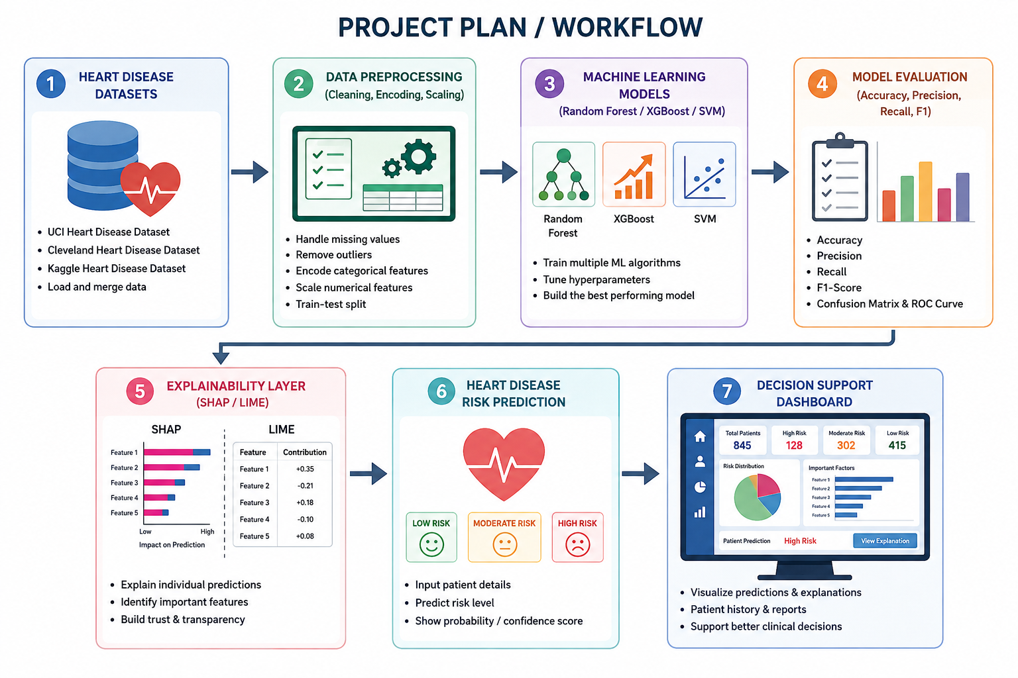
Project Plan:
┌──────────────────────────────┐
│ PHASE 1: DATA COLLECTION │
│ Heart Disease Dataset │
└──────────────┬──────────────┘
↓
┌──────────────────────────────┐
│ PHASE 2: DATA PREPROCESSING │
│ Cleaning • Encoding • Scaling│
└──────────────┬───────────────┘
↓
┌──────────────────────────────┐
│ PHASE 3: MODEL DEVELOPMENT │
│ Random Forest • XGBoost • SVM │
└──────────────┬───────────────┘
↓
┌──────────────────────────────┐
│ PHASE 4: MODEL EVALUATION │
│ Accuracy • Precision • Recall │
│ F1-Score │
└──────────────┬───────────────┘
↓
┌──────────────────────────────┐
│ PHASE 5: EXPLAINABLE │
│ PREDICTION │
│ SHAP • LIME → Risk Prediction │
└──────────────────────────────┘

Slide 10
Expected Outcomes
Accurate early heart disease prediction.
Transparent AI explanations.
Improved trust among healthcare professionals.
Better clinical decision support.
Easy-to-use prediction framework.

Slide 11
Conclusion
The proposed Explainable Machine Learning Framework for Early Heart Disease Prediction combines high prediction accuracy with transparent and interpretable explanations.
By integrating Explainable AI techniques such as SHAP and LIME, the system helps healthcare professionals understand the reasoning behind predictions, enabling informed clinical decisions and supporting early diagnosis to improve patient outcomes.

